Slide 1
IE3085
QUALITY METHODS PROJECT - Group 11
Name | Number | Contribution
Hakan İSPİR | 150322052 | Steps 2, 3, 5, 6, coding
Medine UTANGAÇ | 150318062 | Steps 1, 4 and 6, image search
Ege ASLAN | 150322053 | Steps 2, 3, 5, 6
Hale Nur SARAÇBAŞI | 150323824 | Steps 1, 4 and 6

Slide 2
Introduction
This project focuses on quality control for steel plates used in various industries.
Ensuring high-quality steel plates is crucial for maintaining structural integrity in applications such as construction, automotive, and shipbuilding.
This report presents an analysis based on a real-world dataset, including control charts and fault detection using ML and DL classification models.

Slide 3
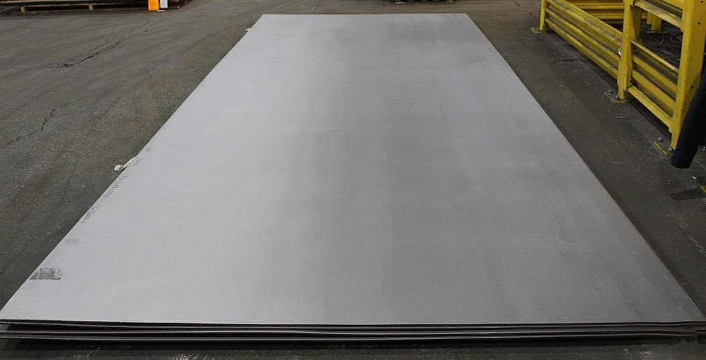
Definition of the Product
Steel plates are flat, rectangular metal plates made of steel. They vary in thickness, strength, and quality depending on their intended application.
Scope of the Usage
Steel sheets are used in a variety of industries, including construction, automotive, and aerospace.

Slide 4
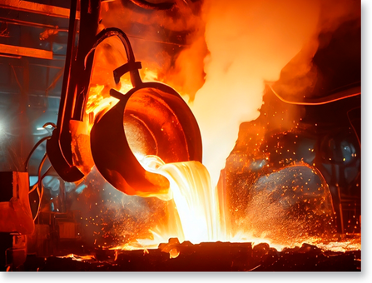
Standard Operating Procedure
Steel Production:
Melting: Raw steel is loaded into a furnace (Blast Furnace or Electric Arc Furnace) to melt.
Alloying: Necessary alloying elements are added to the molten steel to obtain the desired properties.
Casting: Molten steel is passed into molds. Continuous casting is used to form billets or slabs.

Slide 5

Hot Rolling:
The slabs are then heated to high temperatures (generally 1000-1250°C) and fed into a rolling mill.
The heated steel is passed through rollers to reduce the thickness and achieve the desired slab dimensions (length, width and thickness).

Slide 6
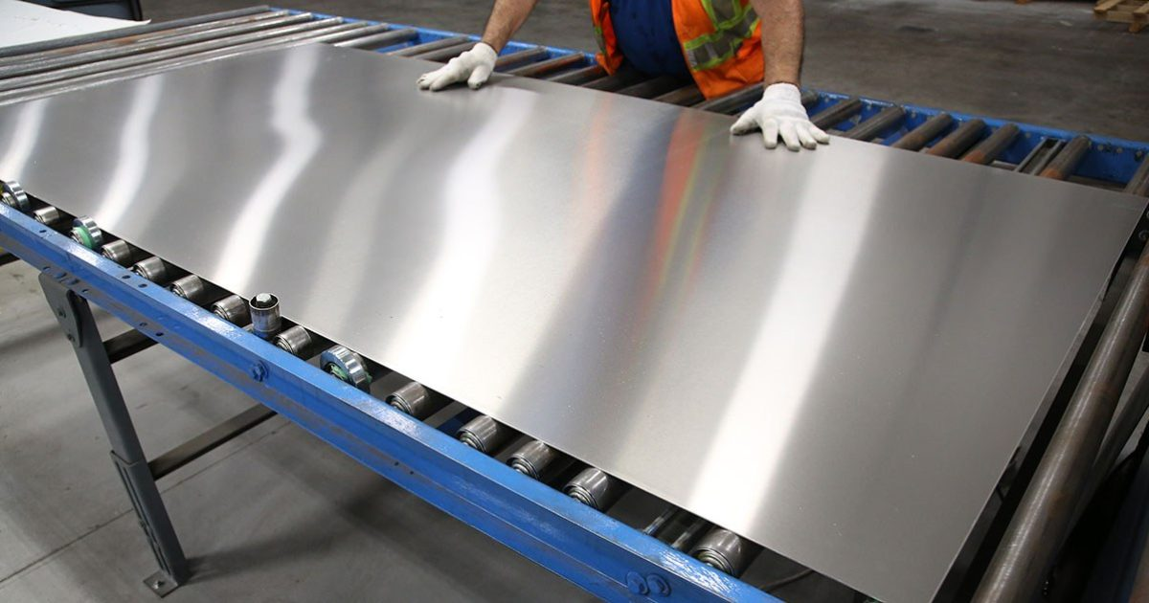
Cooling and Normalizing:
The steel slabs are gradually cooled to room temperature using air or water jets.
In some cases, normalizing (heat treatment) is done to relieve internal stresses and improve the mechanical properties of the steel.
Surface Treatment:
The liquid slabs are cleaned to remove scale or contaminants using mechanical or chemical cleaning methods.
Depending on the requirement, surface finishing (grinding, polishing) can be applied to improve aesthetics or smoothness.

Slide 7
Cutting and Trimming:
Steel sheets are cut to the desired size using automatic cutting machines (shears or plasma cutters).
Quality Control and Inspection:
Mechanical tests are performed to ensure that the sheets meet the required specifications. For example, tensile strength, hardness, elongation
Packing and Shipping:
Finished steel sheets are securely packed and packaged.
The sheets are then transported to customers or warehouses.

Slide 8

Key Product/Process Characteristics
Thickness
Width and Length
Tensile Strength
Hardness
Surface Finish
Flatness
Chemical Composition

Slide 9
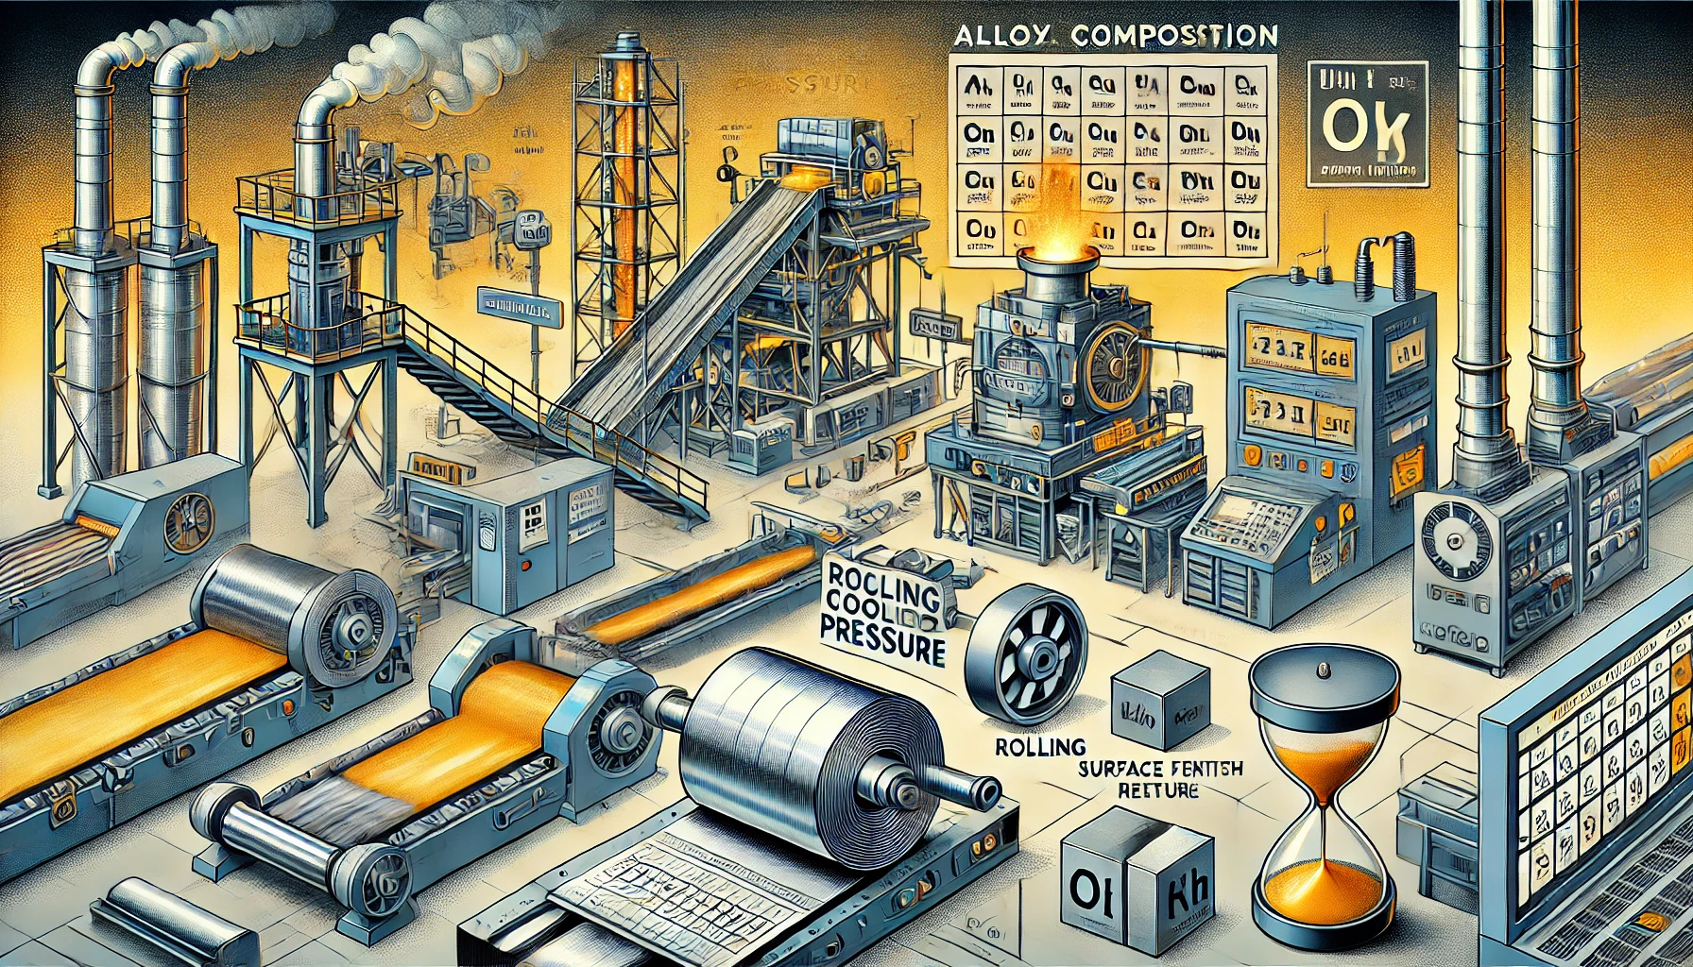
Key Control Characteristics
Temperature Control in Furnace
Rolling Pressure
Cooling Rate
Alloy Composition
Rolling Speed
Cutting Accuracy
Surface Finish Quality
Hardness Testing

Slide 10
Quality Control Technique
The following quality control techniques were selected for this analysis:
1. Statistical Process Control (SPC) using X-bar and S-bar control charts for selected process variables.
2. SPC using P and c-charts for attributes (fault types for our dataset). We had to generate 7 different charts for each, since we have 7 different fault types.
3. Machine learning models (Random Forest classifier and pytorch) to predict fault types based on process data.

Slide 11
Possible Quality Problems
Various quality problems can occur during the production of steel sheets. These problems can occur at any stage of production. They can affect the performance, appearance and suitability of the final product for its intended use.
Problems such as dimensional errors, surface defects, cracking or breaking, warping or warping, surface roughness, corrosion resistance problems, overheating or inadequate cooling and non-uniform alloy composition can occur.

Slide 12
Possible Quality Problems
The dataset identifies seven types of faults that can occur in steel plates:
1. Pastry : Surface texture defects
2. Z_Scratch : Scratches along z-axis
3. K_Scratch : A specific type of scratch
4. Stains : Surface discoloration/marks
5. Dirtiness : Accumulation of unwanted material
6. Bumps : Raised imperfections on the steel surface
7. Other Faults
The total number of faults equal to 100% of the dataset, since this dataset was gotten from UCI and was created to train machine learning for automatic pattern recognition.
Creating 100% faulty products is an unacceptable quality catastrophe, and is a little unrealistic in today’s world.
However, the goal is to use this kind of dataset to detect and minimize faults, which makes it a QC problem.

Slide 13
Control Charts
For variable: X-bar and S-bar control charts
For attributes: P-chart and c-charts.
Variables are selected as Steel Plate Thickness, X_Minimum and Y_minimum and Sum of Luminosity.
Steel_Plate_Thickness: Critical for product quality.
X_Minimum and Y_Minimum: Likely represent positional or size measurements of defects.
Sum_of_Luminosity: May indicate surface characteristics relevant to defect detection.
Attributes are the 7 fault types.
Pastry, Z_Scratch, K_Scatch, Stains, Dirtiness, Bumps, Other_Faults

Slide 14
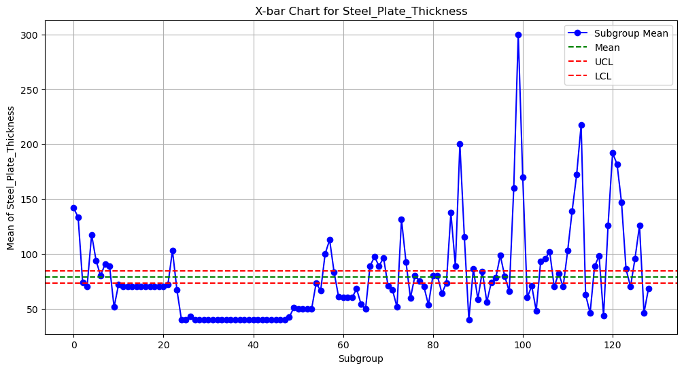
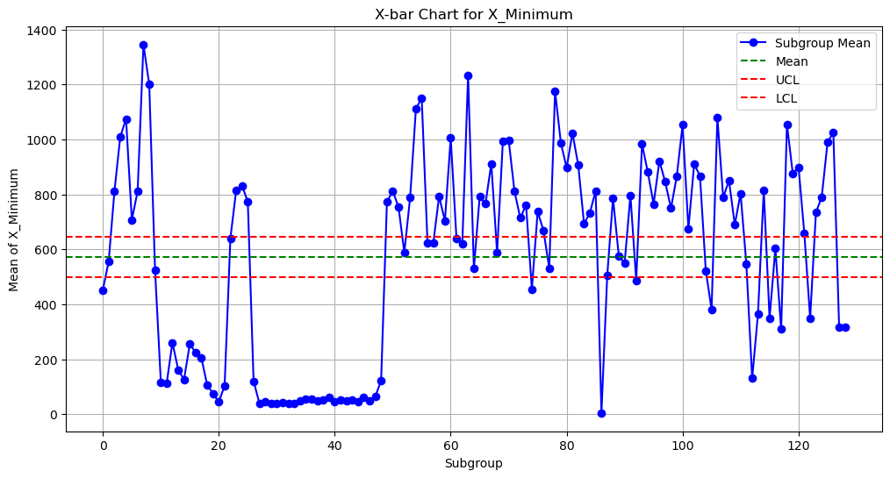
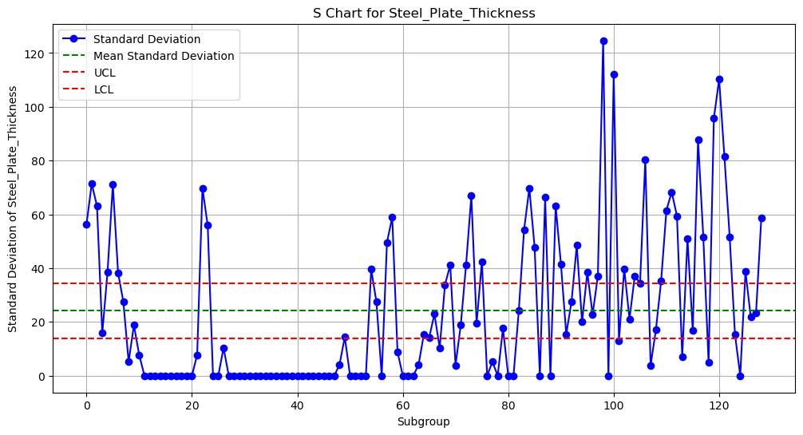
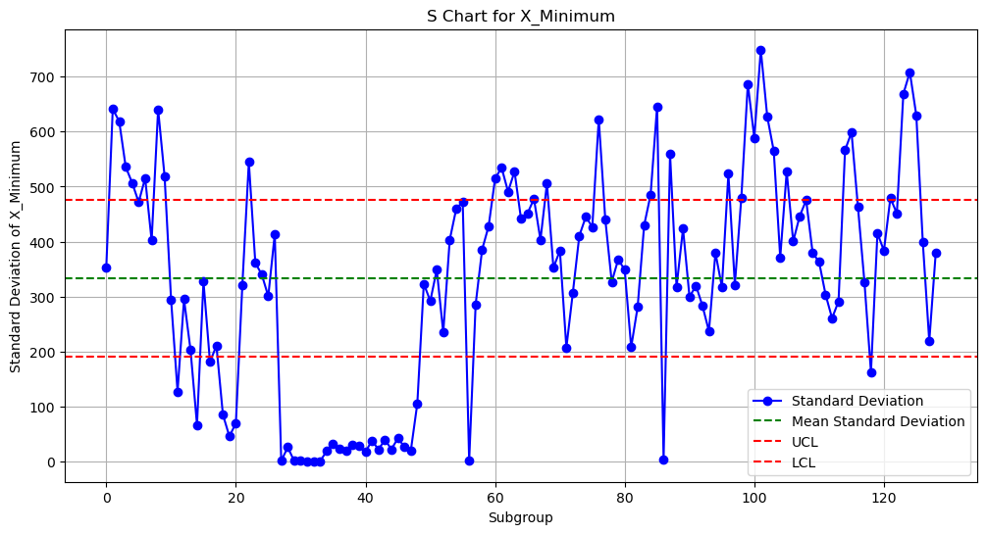
Control Charts for Variables

Slide 15
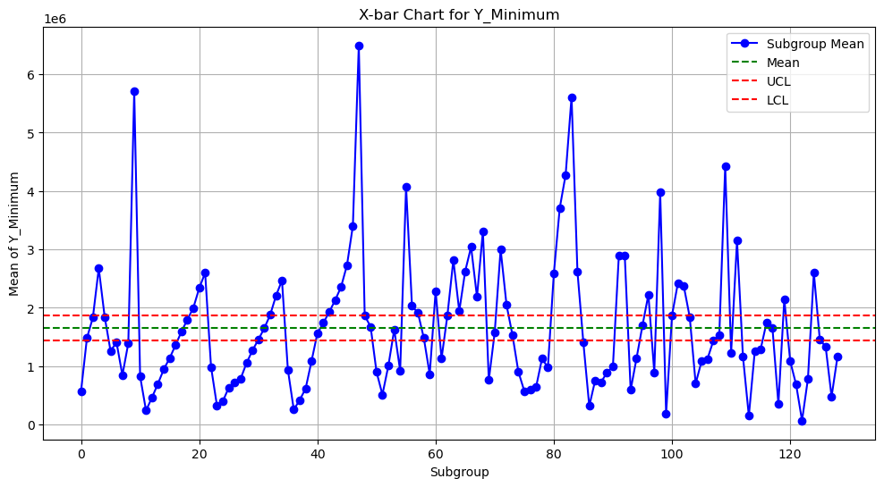
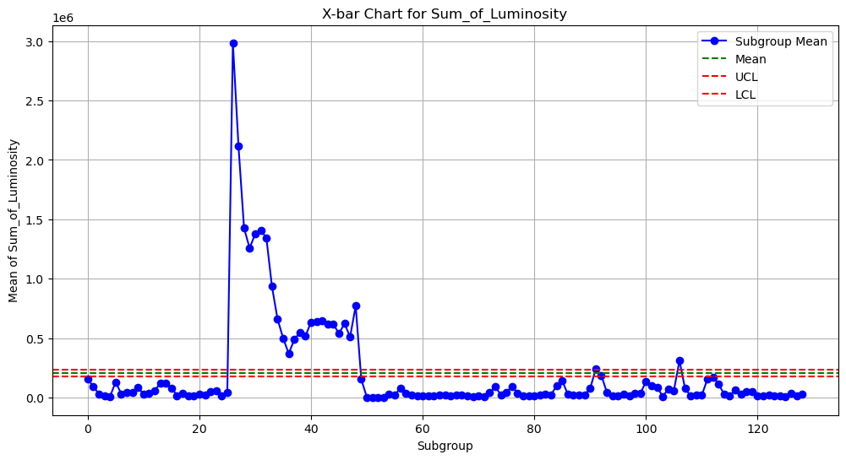
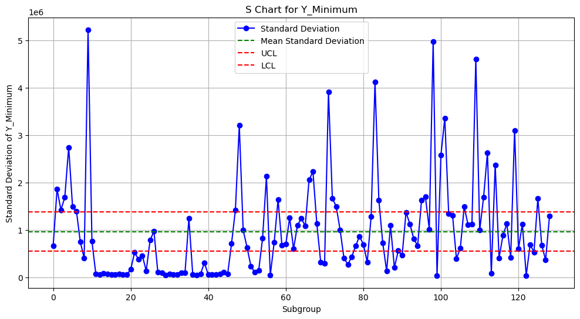
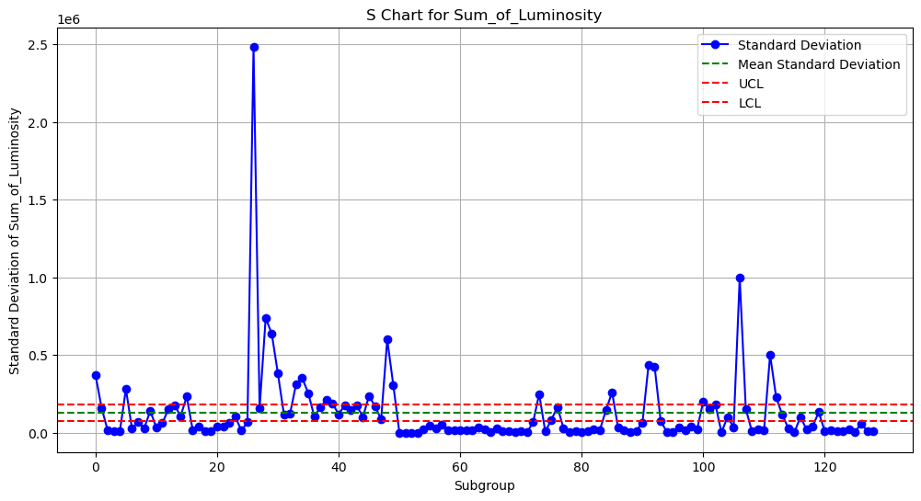
Control Charts for Variables

Slide 16
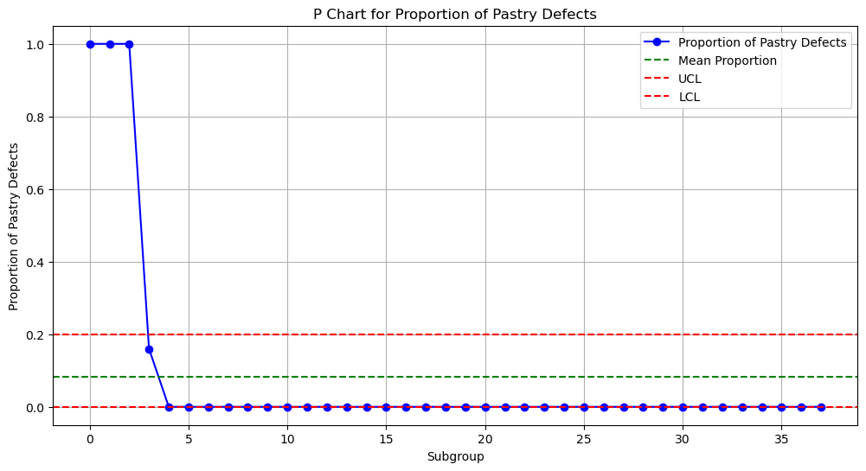
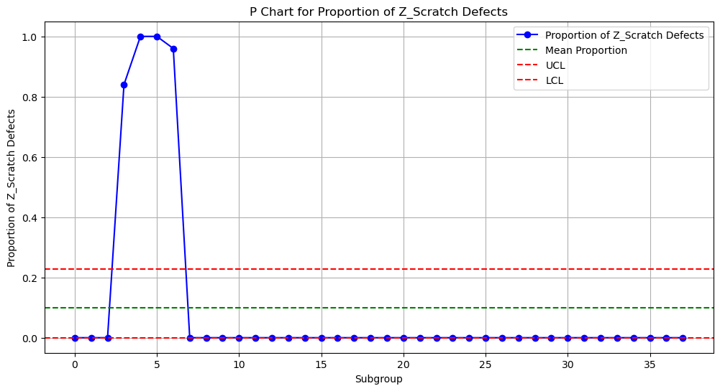
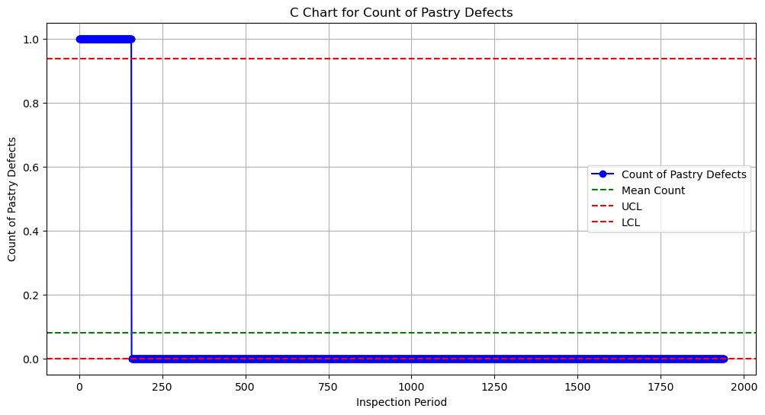
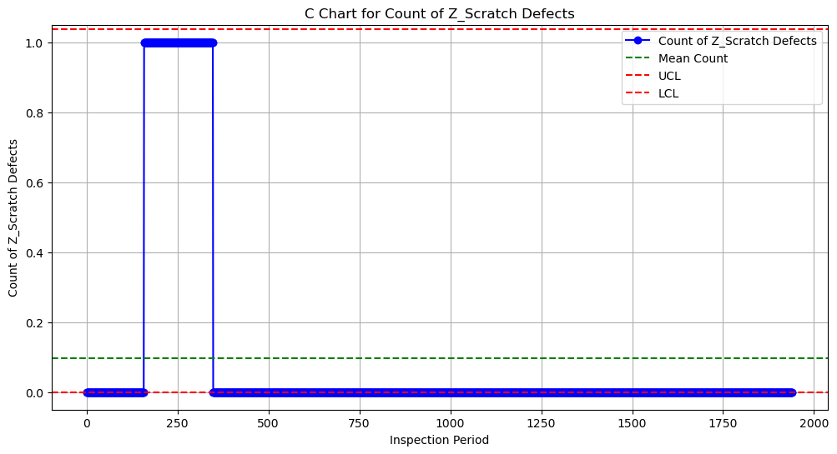
Control Charts for Attributes

Slide 17
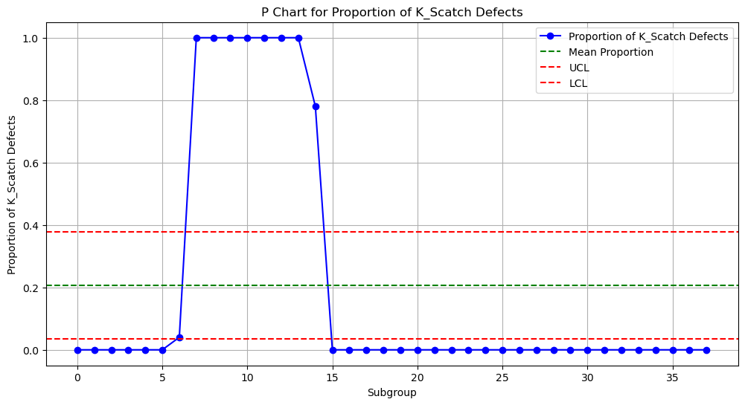
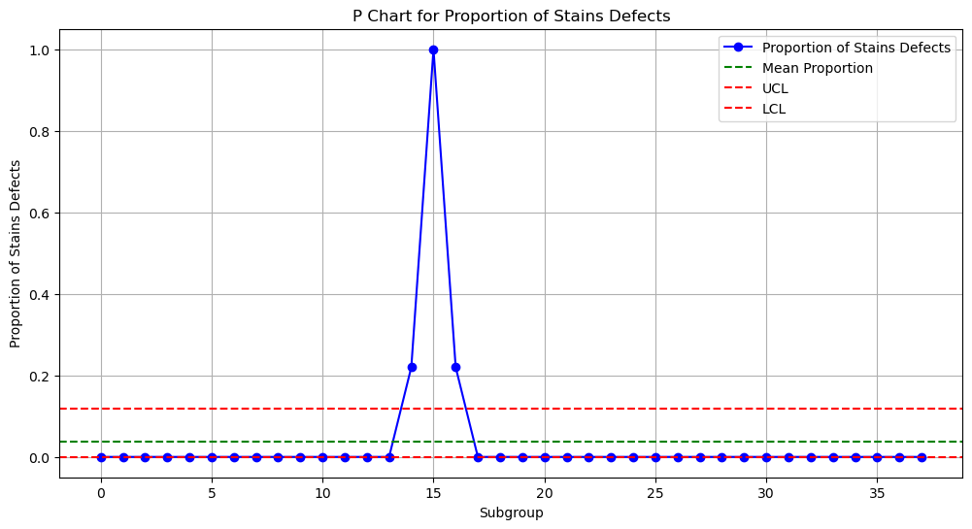
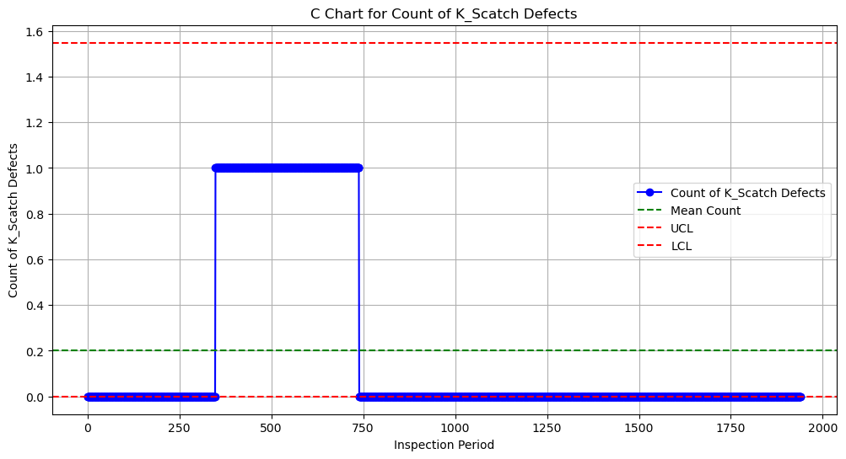
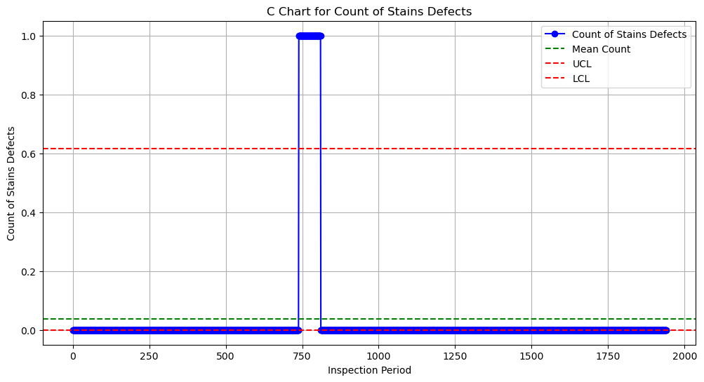
Control Charts for Attributes

Slide 18
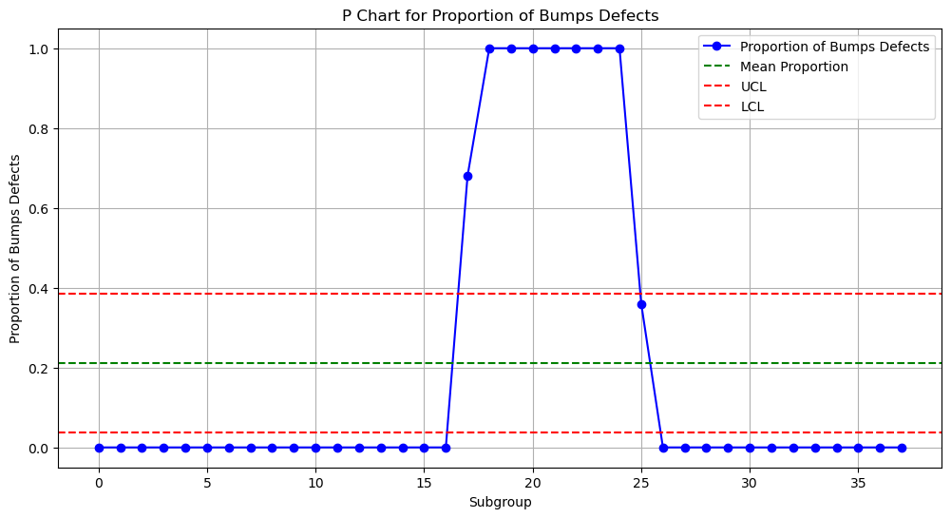
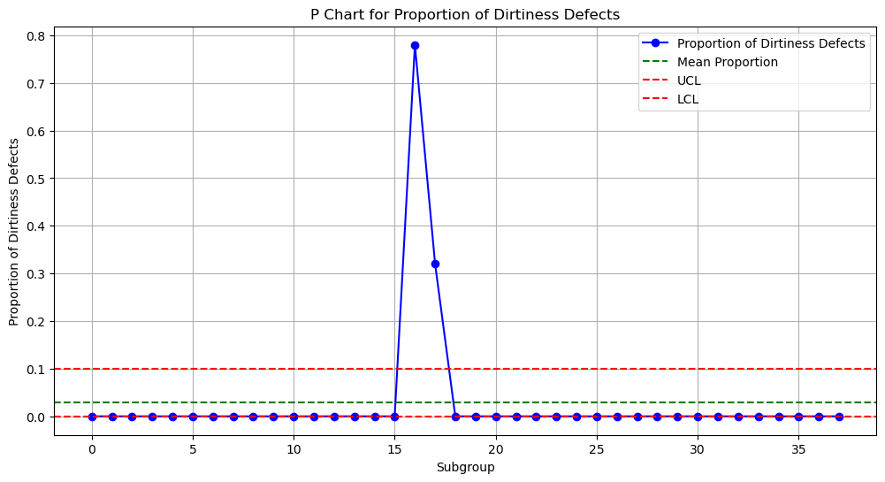
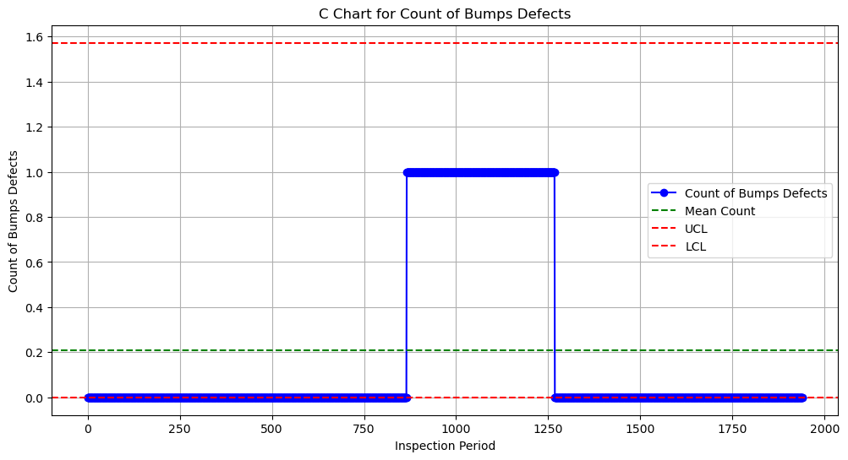
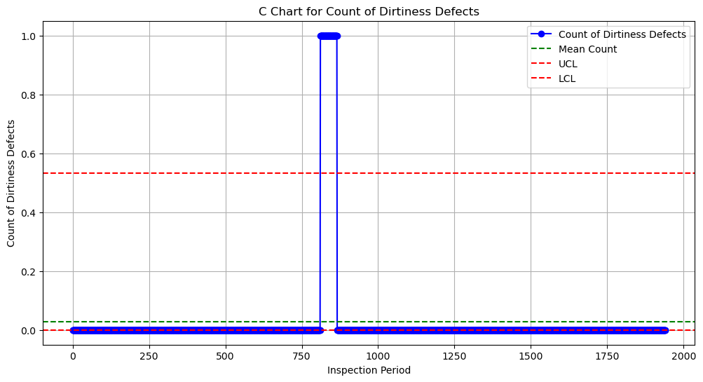
Control Charts for Attributes

Slide 19
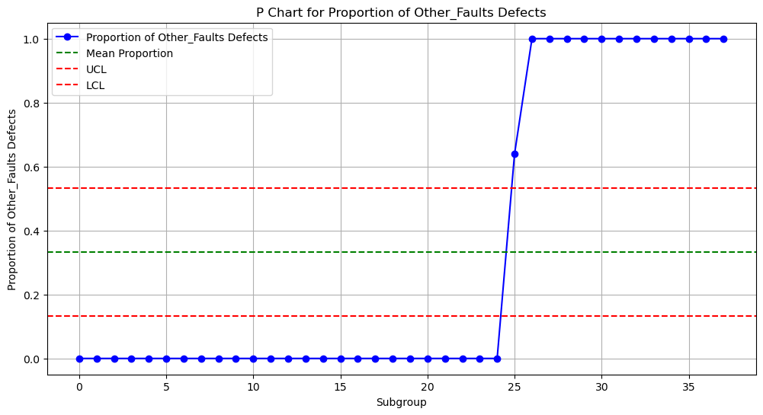
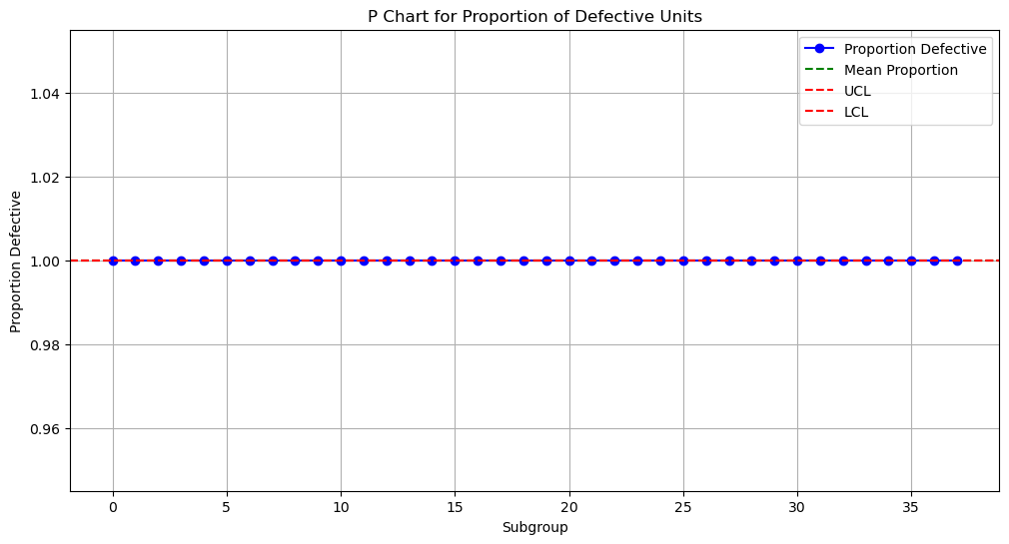
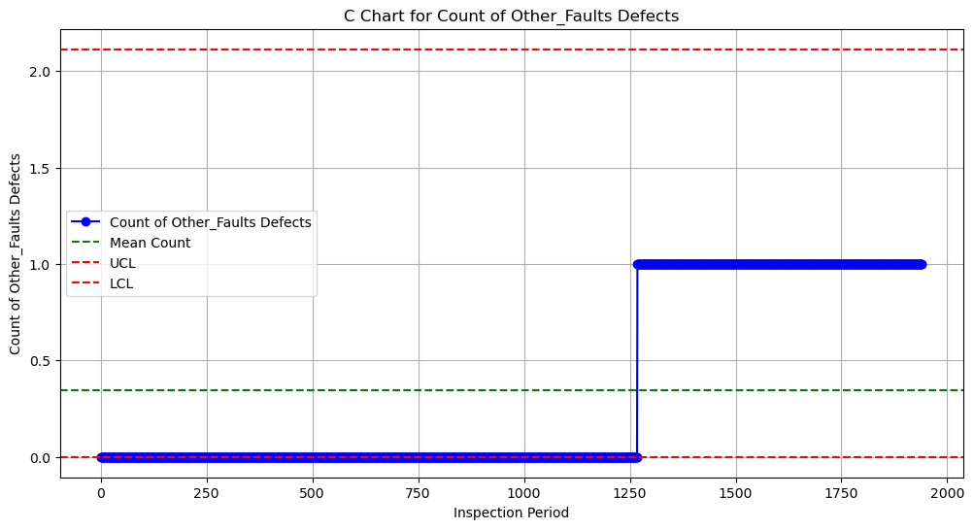
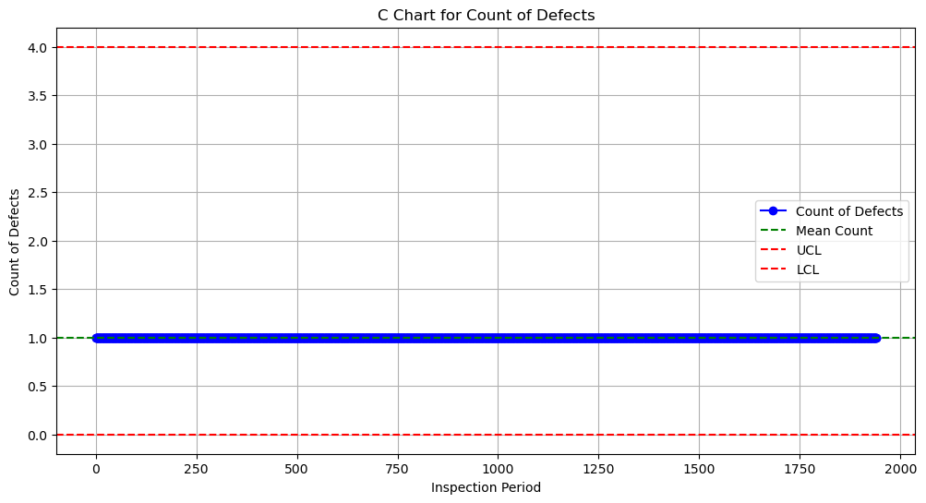
Control Charts for Attributes

Slide 20
SPC Chart
Explanation
Observation:
The X-bar chart shows significant variability in the Steel Plate Thickness across different subgroups.
Some subgroup means exceed the Upper Control Limit (UCL) or fall below the Lower Control Limit (LCL).
Specifically:
Around subgroups 1-20, the means are fluctuating significantly above the UCL.
Around subgroups 60-120, there are multiple points where the means exceed the UCL or fall below the LCL, indicating instability in the process.
Interpretation:
This pattern indicates that the process is out of control. Such variations can be caused by:
Machine issues: Variability in steel plate thickness could be due to improper calibration or worn-out machine parts.
Material inconsistency: Fluctuations in raw material properties may lead to thickness variations.
Operator errors: Inconsistent handling or improper adjustments by operators can introduce variability.

Slide 21
SPC Chart Explanation
Revisions Needed:
Investigate the specific causes during the time periods when the subgroup means exceeded the control limits.
Conduct a root cause analysis focusing on:
Machine calibration: Check whether machines were properly calibrated during production.
Raw material quality: Inspect whether batches of raw materials used during the problematic periods had quality issues.
Operator procedures: Review operator procedures and ensure consistent handling practices.

Slide 22
Further SPC Procedure
To bring the process under control and maintain stability, the following steps should be taken:
Immediate Actions:
Machine maintenance: Regularly inspect and calibrate machines to ensure consistent performance.
Material quality control: Implement stricter quality checks for incoming raw materials to ensure consistent properties.
Operator training: Provide training to operators on best practices for maintaining consistent thickness.

Slide 23
Further SPC Procedure
Long-Term Actions:
Statistical Process Control (SPC) Monitoring:
Continue using X-bar and S-charts to monitor critical variables like Steel Plate Thickness.
Set up real-time monitoring and alerts when subgroup means approach control limits.
Capability Analysis:
Perform a process capability analysis to determine whether the process can consistently meet specifications.
If the process is not capable, consider redesigning the process or using better equipment.
Preventive Measures:
Use preventive maintenance schedules to reduce machine-related variability.
Conduct periodic audits of raw material suppliers to ensure consistent quality.

Slide 24
Quality Control Technique 3: Machine Learning
Firstly, a random Forest classifier (sklearn package) was trained to predict the seven types of faults. The model achieved an accuracy of 68.10% on the test set.
However, since 68% is relatively low, we have decided to use pytorch. The first try only resulted to 40.33% accuracy, which we improved significantly to 88.24%.
This best accuracy was acquired by a set of things, namely regularization using Batch and Dropout layers and hyperparameters.
More improvements, like Transfer Learning and advanced data augmentation proved about no improvements but still is provided in the Appendix.

Slide 25
Quality Control Technique 3: Machine Learning
Accuracy Definition:
Accuracy is the ratio of correctly predicted instances to the total number of instances.
For this project, since it’s a multi-label classification problem, accuracy measures how often the model correctly predicts all fault types for a given sample.
High Accuracy Interpretation:
An accuracy of 87.21% means that in 87.21% of the cases, the model correctly predicted whether each fault type was present or absent in a steel plate.
This is a strong result for a multi-label classification task, especially given the potential imbalance in fault occurrences across different samples.
Next Steps: Since the model achieves a high accuracy, further improvement might require:
1. Collecting more data to reduce overfitting.
2. Balancing the dataset using techniques like oversampling or undersampling.
3. Trying advanced architectures like EfficientNet or transformers for image classification.

Slide 26
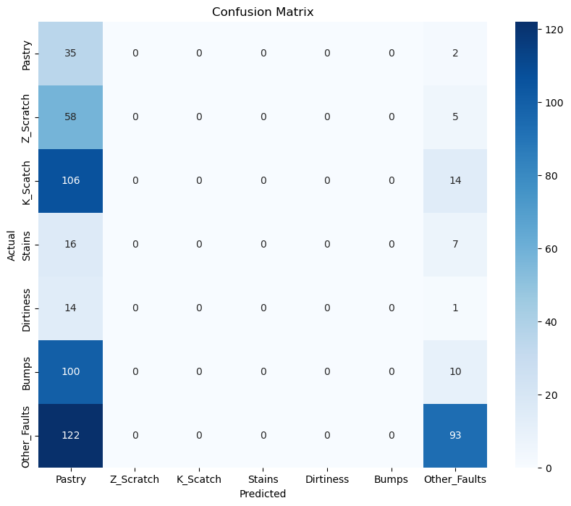
Quality Control Technique 3: Machine Learning
To the right, the confusion matrix of the best solution of the model is shown.
Above it, the logged output of the solution shows the best accuracy and parameters.
Hidden size refers to the number of neurons in the hidden layer(s) of the neural network.
A larger hidden size allows the model to capture more complex patterns but can lead to overfitting and increased computational cost.
Dropout is a regularization technique where a fraction of neurons is randomly "dropped" (i.e., set to zero) during training to prevent overfitting.
The dropout rate specifies the proportion of neurons to drop.
The learning rate controls how much the model’s parameters are adjusted during each update (i.e., step size in gradient descent).
A high learning rate may cause overshooting the optimal solution a.k.a convergence; while low learning rate may cause undershooting and cause algorithm to converge too slowly.

Slide 27
Quality Control Technique 3: Machine Learning
Explanation of the Confusion Matrix:
Diagonal Elements:
The values on the diagonal (top-left to bottom-right) represent correct predictions. For example:
Pastry defects: 35 correctly predicted out of 37 actual Pastry defects.
The higher these diagonal values, the better the model is at correctly classifying each fault type.
Off-Diagonal Elements:
The off-diagonal values represent misclassifications, i.e., where the model predicted the wrong fault type.
For example:
K_Scatch defects were often misclassified as Other_Faults (14 times).

Slide 28
Discussion
The X-bar chart indicates that the process for steel plate production is currently out of control, with significant variability in thickness.
To address this issue, immediate actions such as machine calibration, material quality checks, and operator training are recommended.
Long-term actions including continuous monitoring, capability analysis, and preventive maintenance should be implemented to maintain a stable and capable process.
Therefore, we can say that:
Charts indicate high variations, which means the production is currently out of control.
The ML model has a high accuracy, that means its ability to predict failures is strong.
Actions should be taken to reduce variations, and the ML model should be used in monitoring the potential defects.
This project is in its base a classification problem, namely reducing/detecting the defects in steel order to increase quality, which ML models work very well.

Slide 29
Appendix
quality-methods-project-SPC charts.ipynb
import pandas as pd
# Load the dataset
file_path = "data/Steel_Plates_Processed_Dataset.csv" # Replace with your file path
data = pd.read_csv(file_path)
# Display the first few rows to understand the data structure
print(data.head())
import numpy as np
import matplotlib.pyplot as plt
# Define parameters
sample_size = 15 # Larger sample size (> 10)
num_samples = len(data) // sample_size
subgroups = data["X_Minimum"][: num_samples * sample_size].values.reshape(
num_samples, sample_size
)

Slide 30
Appendix
# Calculate subgroup means and standard deviations
subgroup_means = np.mean(subgroups, axis=1)
subgroup_stds = np.std(
subgroups, axis=1, ddof=1
) # Use ddof=1 for sample standard deviation
# Calculate overall mean and mean standard deviation
X_double_bar = np.mean(subgroup_means)
S_bar = np.mean(subgroup_stds)
# Control limits for X-bar chart
A3 = 0.267 # Constant for sample size 15 (from SPC control chart constants table)
UCL_X = X_double_bar + A3 * S_bar
LCL_X = X_double_bar - A3 * S_bar
# Control limits for S chart
B4, B3 = 1.924, 0.076 # Constants for sample size 15
UCL_S = B4 * S_bar
LCL_S = B3 * S_bar
# Plot X-bar chart
plt.figure(figsize=(12, 6))
plt.plot(subgroup_means, marker="o", linestyle="-", color="b", label="Subgroup Mean")
plt.axhline(X_double_bar, color="g", linestyle="--", label="Mean")
plt.axhline(UCL_X, color="r", linestyle="--", label="UCL")
plt.axhline(LCL_X, color="r", linestyle="--", label="LCL")
plt.title("X-bar Chart for X_Minimum (Sample Size > 10)")
plt.xlabel("Subgroup")
plt.ylabel("Mean")
plt.legend()
plt.grid(True)
plt.show()
# Plot S chart
plt.figure(figsize=(12, 6))
plt.plot(
subgroup_stds, marker="o", linestyle="-", color="b", label="Standard Deviation"
)
plt.axhline(S_bar, color="g", linestyle="--", label="Mean Standard Deviation")
plt.axhline(UCL_S, color="r", linestyle="--", label="UCL")
plt.axhline(LCL_S, color="r", linestyle="--", label="LCL")
plt.title("S Chart for X_Minimum (Sample Size > 10)")
plt.xlabel("Subgroup")
plt.ylabel("Standard Deviation")
plt.legend()
plt.grid(True)
plt.show()

Slide 31
Appendix
# Check data columns
print(data.columns)
# Check the unique values and their counts in the Defective column
print(data['Defective'].value_counts())
# Check the distribution of the Total_Defects column
print(data["Total_Defects"].value_counts())
import numpy as np
import matplotlib.pyplot as plt
# Fault type columns
fault_types = [
"Pastry",
"Z_Scratch",
"K_Scatch",
"Stains",
"Dirtiness",
"Bumps",
"Other_Faults",
]
# Sample size for subgroups
sample_size = 50
num_subgroups = len(data) // sample_size
# Function to plot P-chart for a given fault type
def plot_p_chart(fault_type):
# Calculate proportion of defects for the fault type
defects = (
data[fault_type][: num_subgroups * sample_size]
.values.reshape(num_subgroups, sample_size)
.sum(axis=1)
)
proportion_defects = defects / sample_size
p_bar = np.mean(proportion_defects)
# Control limits for P-chart
UCL_P = p_bar + 3 * np.sqrt((p_bar * (1 - p_bar)) / sample_size)
LCL_P = max(p_bar - 3 * np.sqrt((p_bar * (1 - p_bar)) / sample_size), 0)
# Plot P-chart
plt.figure(figsize=(12, 6))
plt.plot(
proportion_defects,
marker="o",
linestyle="-",
color="b",
label=f"Proportion of {fault_type} Defects",
)
plt.axhline(p_bar, color="g", linestyle="--", label="Mean Proportion")
plt.axhline(UCL_P, color="r", linestyle="--", label="UCL")
plt.axhline(LCL_P, color="r", linestyle="--", label="LCL")
plt.title(f"P Chart for Proportion of {fault_type} Defects")
plt.xlabel("Subgroup")
plt.ylabel(f"Proportion of {fault_type} Defects")
plt.legend()
plt.grid(True)
plt.show()
# Generate P-charts for all fault types
for fault_type in fault_types:
plot_p_chart(fault_type)

Slide 32
Appendix
# Function to plot C-chart for a given fault type
def plot_c_chart(fault_type):
# Count defects for the fault type
defects = data[fault_type].values
C_bar = np.mean(defects)
# Control limits for C-chart
UCL_C = C_bar + 3 * np.sqrt(C_bar)
LCL_C = max(C_bar - 3 * np.sqrt(C_bar), 0)
# Plot C-chart
plt.figure(figsize=(12, 6))
plt.plot(
defects,
marker="o",
linestyle="-",
color="b",
label=f"Count of {fault_type} Defects",
)
plt.axhline(C_bar, color="g", linestyle="--", label="Mean Count")
plt.axhline(UCL_C, color="r", linestyle="--", label="UCL")
plt.axhline(LCL_C, color="r", linestyle="--", label="LCL")
plt.title(f"C Chart for Count of {fault_type} Defects")
plt.xlabel("Inspection Period")
plt.ylabel(f"Count of {fault_type} Defects")
plt.legend()
plt.grid(True)
plt.show()
# Generate C-charts for all fault types
for fault_type in fault_types:
plot_c_chart(fault_type)

Slide 33
Appendix
# Create a binary 'Defective' column: 1 if any fault is present, 0 otherwise
data["Defective"] = data[
["Pastry", "Z_Scratch", "K_Scatch", "Stains", "Dirtiness", "Bumps", "Other_Faults"]
].max(axis=1)
# Define sample size and number of subgroups
sample_size = 50
num_subgroups = len(data) // sample_size
# Calculate proportion of defectives for each subgroup
defective_counts = (
data["Defective"][: num_subgroups * sample_size]
.values.reshape(num_subgroups, sample_size)
.sum(axis=1)
)
proportion_defective = defective_counts / sample_size
p_bar = np.mean(proportion_defective)
# Control limits for P chart
UCL_P = p_bar + 3 * np.sqrt((p_bar * (1 - p_bar)) / sample_size)
LCL_P = max(p_bar - 3 * np.sqrt((p_bar * (1 - p_bar)) / sample_size), 0)
# Plot P-chart
plt.figure(figsize=(12, 6))
plt.plot(
proportion_defective,
marker="o",
linestyle="-",
color="b",
label="Proportion Defective",
)
plt.axhline(p_bar, color="g", linestyle="--", label="Mean Proportion")
plt.axhline(UCL_P, color="r", linestyle="--", label="UCL")
plt.axhline(LCL_P, color="r", linestyle="--", label="LCL")
plt.title("P Chart for Proportion of Defective Units")
plt.xlabel("Subgroup")
plt.ylabel("Proportion Defective")
plt.legend()
plt.grid(True)
plt.show()

Slide 34
Appendix
quality-methods-project-TL.ipynb
# imports
import itertools
import numpy as np
import time, os
import pandas as pd
from matplotlib import pyplot as plt
import seaborn as sns
from PIL import Image
from torchvision import transforms
import torch
import torch.nn as nn
import torch.optim as optim
from torchvision import models, transforms
from torch.utils.data import DataLoader, Dataset
from torch.amp import autocast, GradScaler
from sklearn.metrics import accuracy_score, classification_report
# checks
import torch
print("CUDA Available:", torch.cuda.is_available())
print("PyTorch CUDA Version:", torch.version.cuda)
print("cuDNN Available:", torch.backends.cudnn.is_available())
print("cuDNN Version:", torch.backends.cudnn.version())
print("GPU:", torch.cuda.get_device_name(0) if torch.cuda.is_available() else "No GPU detected")

Slide 35
Appendix
quality-methods-project-TL.ipynb
# Load the dataset
data = pd.read_csv("data/Steel_Plates_Processed_Dataset.csv")
# Display the first few rows to confirm loading
data.head()
# generate heatmap images
# Create a directory to save the generated images
output_dir = "./fault_images"
os.makedirs(output_dir, exist_ok=True)
# Generate heatmap images for each row of the dataset
def generate_images(data, output_dir):
for i, row in data.iterrows():
plt.figure(figsize=(3, 1))
sns.heatmap([row.values], cmap="viridis", cbar=False)
plt.axis("off")
plt.savefig(
f"{output_dir}/fault_{i}.png", bbox_inches="tight", pad_inches=0, dpi=50
)
plt.close()
# Generate images for the entire dataset
generate_images(data.iloc[:, :-7], output_dir)

Slide 36
Appendix
quality-methods-project-TL.ipynb
# Prepare labels
from sklearn.model_selection import train_test_split
labels = data.iloc[:, -7:].values
# Sort the image files to ensure consistent ordering
image_files = sorted(os.listdir(output_dir))
# Perform train-test split
train_files, test_files, train_labels, test_labels = train_test_split(
image_files, labels, test_size=0.3, random_state=42
)
# define image transformations
from torchvision import transforms
# Define transformations with augmentations for training data
train_transform = transforms.Compose(
[
transforms.Resize((64, 64)), # Resize images to 64x64
transforms.RandomHorizontalFlip(), # Random horizontal flip
transforms.RandomVerticalFlip(), # Random vertical flip
transforms.RandomRotation(15), # Random rotation within ±15 degrees
transforms.ColorJitter(
brightness=0.2, contrast=0.2, saturation=0.2
), # Color jitter
transforms.RandomResizedCrop(64, scale=(0.8, 1.0)), # Random crop and rescale
transforms.ToTensor(),
transforms.Normalize((0.5,), (0.5,)),
]
)
# Define transformations without augmentations for test data
test_transform = transforms.Compose(
[
transforms.Resize((64, 64)),
transforms.ToTensor(),
transforms.Normalize((0.5,), (0.5,)),
]
)

Slide 37
Appendix
quality-methods-project-TL.ipynb
# Define hyperparameter grid
hidden_sizes = [64, 128, 256]
dropout_rates = [0.3, 0.5]
learning_rates = [0.001, 0.0005]
num_epochs = 10
best_accuracy = 0
best_params = None
from sklearn.metrics import accuracy_score, classification_report, confusion_matrix
import seaborn as sns
best_accuracy = 0
best_params = None
# Hyperparameter tuning loop
for hidden_size, dropout_rate, learning_rate in itertools.product(
hidden_sizes, dropout_rates, learning_rates
):
print(
f"Testing configuration: Hidden Size={hidden_size}, Dropout={dropout_rate}, LR={learning_rate}"
)

Slide 38
Appendix
quality-methods-project-TL.ipynb
# Load and modify ResNet-18
model = models.resnet18(weights=models.ResNet18_Weights.DEFAULT)
model.fc = nn.Sequential(
nn.Linear(model.fc.in_features, hidden_size),
nn.ReLU(),
nn.Dropout(dropout_rate),
nn.Linear(hidden_size, 7), # 7 output classes
)
model = model.to("cuda")
criterion = nn.BCEWithLogitsLoss()
optimizer = optim.Adam(model.parameters(), lr=learning_rate)
scaler = GradScaler("cuda")
# Training loop
for epoch in range(num_epochs):
model.train()
epoch_loss = 0.0
for inputs, labels in train_loader:
inputs, labels = inputs.to("cuda"), labels.to("cuda")
optimizer.zero_grad()
with autocast("cuda"):
outputs = model(inputs)
loss = criterion(outputs, labels)
scaler.scale(loss).backward()
scaler.step(optimizer)
scaler.update()
from sklearn.metrics import accuracy_score, classification_report, confusion_matrix
import seaborn as sns
best_accuracy = 0
best_params = None
# Hyperparameter tuning loop
for hidden_size, dropout_rate, learning_rate in itertools.product(
hidden_sizes, dropout_rates, learning_rates
):
print(
f"Testing configuration: Hidden Size={hidden_size}, Dropout={dropout_rate}, LR={learning_rate}"
)

Slide 39
Appendix
quality-methods-project-TL.ipynb
epoch_loss += loss.item()
# Evaluation loop
model.eval()
y_true, y_pred = [], []
with torch.no_grad():
for inputs, labels in test_loader:
inputs, labels = inputs.to("cuda"), labels.to("cuda")
with autocast("cuda"):
outputs = model(inputs)
outputs = torch.sigmoid(outputs)
y_true.extend(labels.cpu().numpy())
y_pred.extend((outputs.cpu().numpy() > 0.5).astype(int))
# Calculate accuracy
y_true = np.array(y_true)
y_pred = np.array(y_pred)
accuracy = accuracy_score(y_true.flatten(), y_pred.flatten())
print(f"Configuration Accuracy: {accuracy * 100:.2f}%")
# Classification report and confusion matrix
print("Classification Report:")
print(
classification_report(
y_true,
y_pred,
target_names=[
"Pastry",
"Z_Scratch",
"K_Scatch",
"Stains",
"Dirtiness",
"Bumps",
"Other_Faults",
],
)
)

Slide 40
Appendix
quality-methods-project-TL.ipynb
conf_matrix = confusion_matrix(y_true.argmax(axis=1), y_pred.argmax(axis=1))
plt.figure(figsize=(10, 8))
sns.heatmap(
conf_matrix,
annot=True,
fmt="d",
cmap="Blues",
xticklabels=[
"Pastry",
"Z_Scratch",
"K_Scatch",
"Stains",
"Dirtiness",
"Bumps",
"Other_Faults",
],
yticklabels=[
"Pastry",
"Z_Scratch",
"K_Scatch",
"Stains",
"Dirtiness",
"Bumps",
"Other_Faults",
],
)
plt.title("Confusion Matrix")
plt.xlabel("Predicted")
plt.ylabel("Actual")
plt.show()
# Track the best configuration
if accuracy > best_accuracy:
best_accuracy = accuracy
best_params = (hidden_size, dropout_rate, learning_rate)
print(
f"Best Accuracy: {best_accuracy * 100:.2f}% with params: Hidden Size={best_params[0]}, Dropout={best_params[1]}, LR={best_params[2]}"
)

Slide 41
References
Dua, D., & Graff, C. (2019). UCI Machine Learning Repository SteelPlatesFaultsDataSetSteel Plates Faults Data SetSteelPlatesFaultsDataSet. Irvine, CA: University of California, School of Information and Computer Science. https://archive.ics.uci.edu/dataset/198/steel+plates+faults

